Slide 1
Communication:
A Critical Tool for Conflict Resolution
By
Dr. Bilhatu Kumah Dagari
08036153436
bilhatudagari@gmail.com
Department of Educational Psychology and Counselling,
Faculty of Education,
Ahmadu Bello University, Zaria, Nigeria.
Being a Lead paper presented at The 9th Annual International Conference of The Association of Professional Counsellors in Nigeria (APROCON) taking place from August 5th – 9th, at Senator Anyim Pius Anyim Auditorium, Michael Okpara University of Agriculture, Umudike, Abia State, Nigeria.

Slide 2
Introduction: Communication and Conflict
Conflict is a situation where there is disagreement between two or more people, a struggle or contest between people with opposing needs, ideas, beliefs, values or goals (Lewis, 1992).
Hart (2002) opines that Conflict is a state of opposition, disagreement or incompatibility between two or more people or groups of people which is sometimes characterized by physical violence or assault.
Wilmot and Hocker (2009) define conflict as a situation where two independent parties with incompatible goals, interference perception, and a limitation of resources engage in a struggle.
However, sometimes these differences can grow to enormous proportion to where they become detrimental to the involved parties and conflict could result.
Conflict is a natural outcome of human interaction.
It arises from differences in goals, values, and resources.
Miscommunication often fuels conflict escalation.
Conflict is not inherently negative — its management defines its impact.
Effective communication is central to conflict resolution.

Slide 3
What is Communication?
The word ‘’communication’’ which is a noun, originates from the Latin word ‘’communes’’ denoting ‘’ common’’ and ‘’communicare’’ meaning to share and communicate, to participate, interchange of thoughts, to give and receive information.
The Oxford Advanced Learner’s dictionary 8th edition, defines communication as the activity or process of expressing ideas and feelings or of giving people information.
Combs (1976), states that communication is more than words, and as such it is a function of common meanings, the over lapping of the perception fields of the communicator and communicatee.
Communication is central to all human interactions — simple in concept, complex in practice.

Slide 4
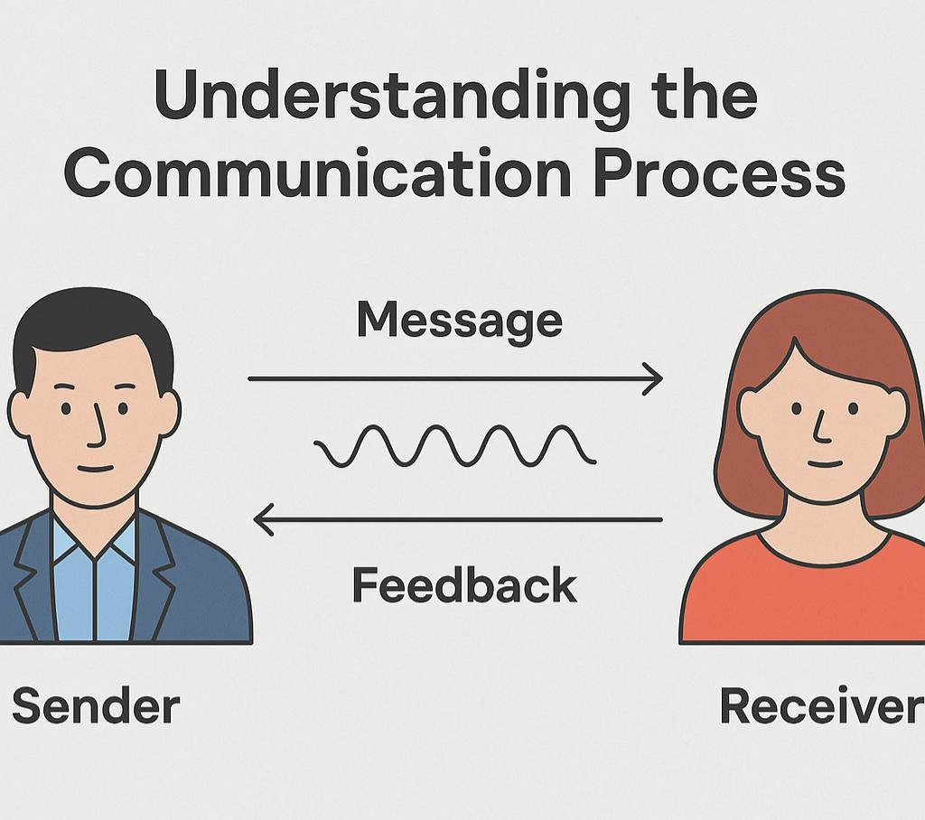
Understanding the Communication Process
Communication is a dyadic process involving transmission and feedback (Weaver & Shannon, 1945).
Encoding occurs when the sender formulates and delivers a message; decoding happens as the receiver interprets it (Weaver & Shannon, 1945).
Effective communication depends on shared language and cultural background (Garth, Jennifer & Hill, 2000).
Noise —any interference in the channel—can distort meaning at any stage of the process (Isola, 2025).
Miscommunication caused by noise often escalates conflict and misunderstanding.

Slide 5
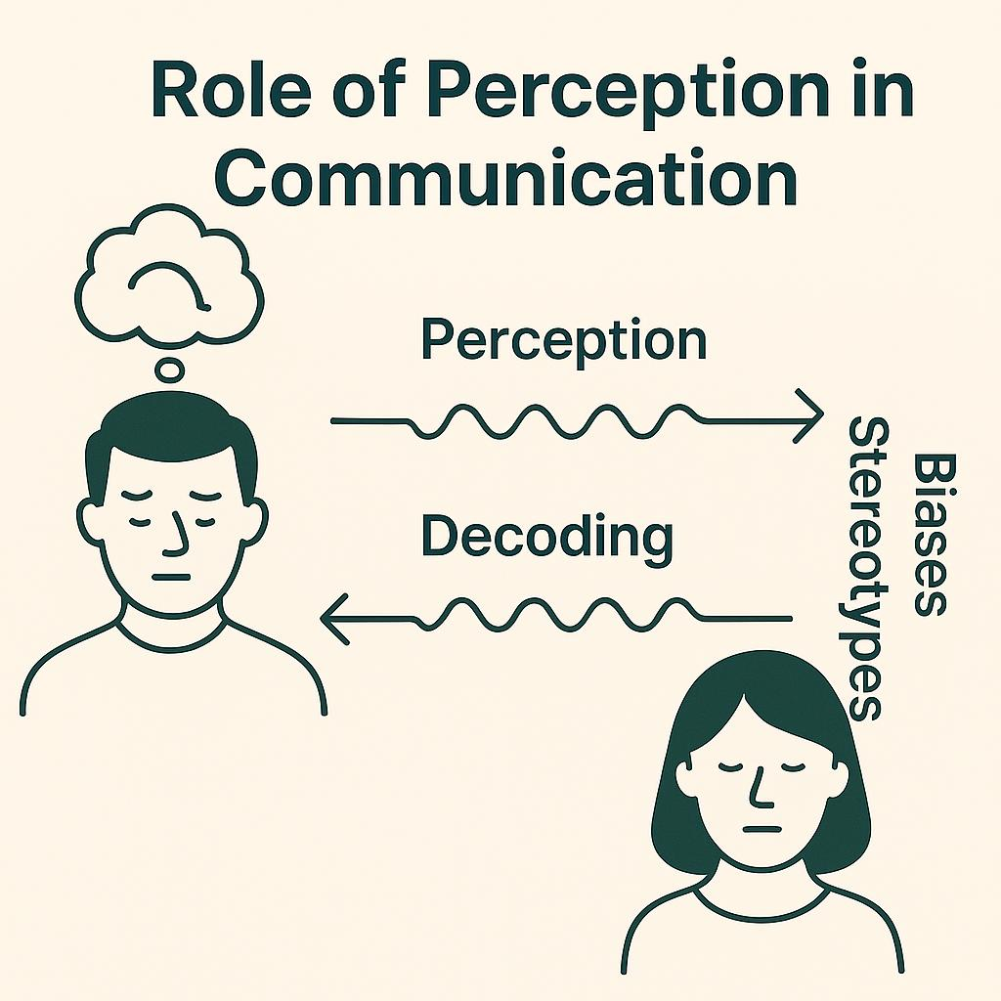
The Role of Perception in Communication
Perception shapes how messages are encoded, transmitted, and decoded (Garth, Jennifer & Hill, 2000).
It is subjective, influenced by values, moods, personality, and experience (Kaufman, 2003).
In conflict situations, perceptual filters affect how individuals interpret others’ intentions (Isola, 2025).
Biases and stereotypes lead to distorted messages and can escalate misunderstanding (Kaufman, 2003; Isola, 2009).
Accurate perception is essential for effective dialogue and conflict resolution.

Slide 6
Barriers to Effective Communication
According to (Ajala, 2000; Dagari, 2009);
Sender – related barriers:
Ambiguous or harsh language
Poor word choice or tone
Inappropriate delivery method
Reflects lack of communication skill
Receiver – related barriers:
Inattention or lack of interest
Misinterpretation of message
Emotional triggers from unclear feedback
Medium-related challenges:
Written: prone to delays
Verbal: susceptible to perceptual distortion
Influenced by bias, stereotypes, and past experiences.
Miscommunication in any of these areas can escalate conflict instead of resolving it

Slide 7
Improving Perception to Enhance Communication
According to (Garth et al., 2000);
Be open to other perspectives to challenge and refine your assumptions.
Embrace the ability to change one’s views when necessary—rigidity distorts perception.
Seek out diverse opinions to inform better, inclusive decision-making.
Reflect on past errors by testing whether faulty perception influenced your judgments.
Regularly assess personal perceptions to minimize miscommunication.
Other Contextual Barriers to Communication
Linguistic barriers (language or dialect differences)
Psychological & emotional issues (stress, trauma, anxiety)
Physical challenges (noise, poor technology, distance)
Cultural and societal differences
Organizational structures and hierarchy
Attitude and perception mismatches

Slide 8
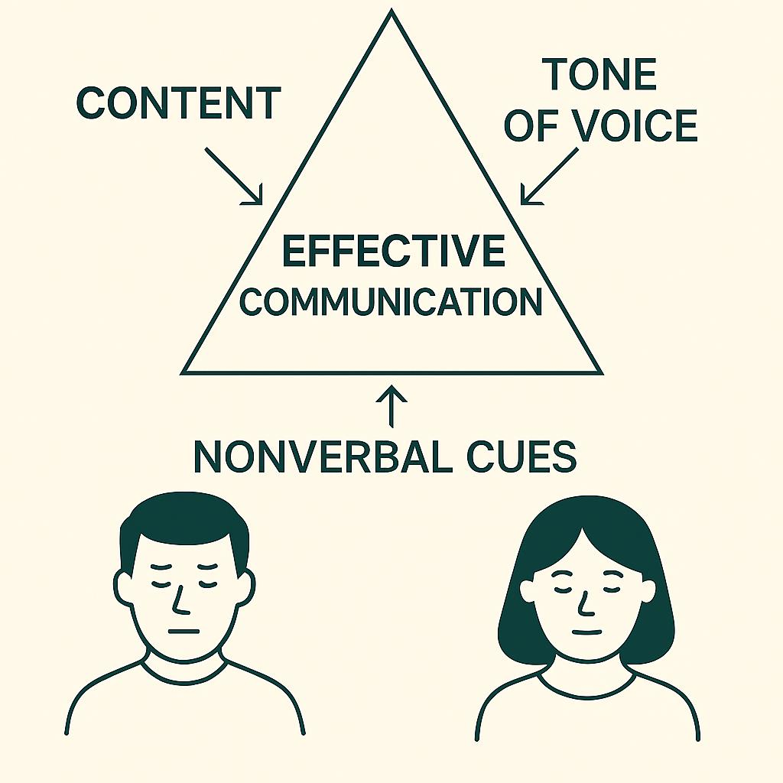
Effective Communication
Communication is not just what is said, but why and how it is shared.
Every message has three components:
Content (the actual words)
Tone of voice
Nonverbal cues (gestures, facial expressions)
These components must align for the message to be clearly understood (Wright, 2001).
Ineffective communication leads to mistrust, tension, and emotional disconnect (Ezeilo, 1995).
Effective communication involves:
Clarity and empathy
Active listening and emotional awareness
Respectful tone and courteous behavior
It fosters connection, trust, and conflict resolution (Dagari, 2009)

Slide 9
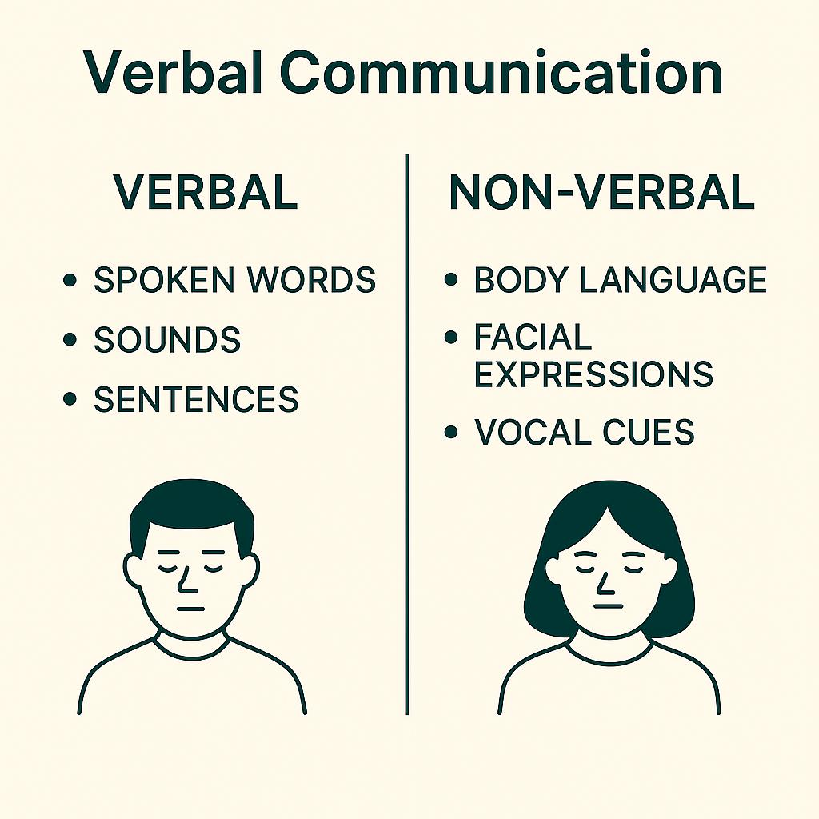
Verbal Communication
Dagari, 2009, highlighted that verbal communication;
Involves the use of spoken words, sounds, and sentences to express thoughts and emotions.
Enables direct, face-to-face interaction with immediate feedback and clarification.
Facilitates cognitive engagement—asking questions, explaining, and resolving ambiguity.
Often accompanied by non-verbal cues (gestures, tone, facial expressions) that shape meaning.
Vocal elements like pitch, rhythm, silence, and utterances (e.g., “uh-huh”, sighs) also convey intent.
Effective communication requires interpreting both verbal and non-verbal signals in context.

Slide 10
Speaking Methods and Rules
Speaking is a mutual exchange of ideas, emotions, and intentions.
Tone of voice can alter the meaning of a message—even when the words remain the same (Wright, 2001).
Politeness and emotional control are essential, especially in moments of anger or familiarity.
We often focus on what we say, but not how we say it.
Recommended Speaking Methods by (Van-Pelt, 2002):
Show interest in the person you’re speaking with—demonstrate care and attentiveness.
Speak politely to everyone, regardless of age or status, to earn respect and engagement.
Use “I-messages” to express displeasure constructively and avoid blame:
Example: “I feel hurt when I’m interrupted,” instead of “You always interrupt me.”

Slide 11
Speaking Rules for Effective Conversation
According to Van-Pelt (2005), the following are rules for effective conversation;
Choose the right time to speak — timing affects receptiveness.
Use a pleasant tone — how you speak matters as much as what you say.
Be clear and specific — avoid vague or muddled speech.
Stay positive — choose appreciative and constructive language.
Show courtesy and respect — listen even when you disagree.
Be sensitive — respond with empathy to others’ emotions.
Practice regularly — conversation is an art that improves with use.

Slide 12
Barriers to Effective Speaking
Van-Pelt, (2002), highlighted the barriers to effective speaking as follows;
Solution – sending: Giving commands or orders (e.g., “Hurry up!”) shuts down open dialogue.
Moralizing: Using “should,” “must,” or “better” statements can provoke resistance.
Put-downs: Criticism, ridicule, or blame damages trust and openness.
Judgmental speech: Interpreting, diagnosing, or psychoanalyzing others mid-conversation hinders connection.
These habits block authentic expression and reduce the effectiveness of communication.

Slide 13
SOLER: Active Listening Framework
Egan (1994), proposes the SOLER framework for active listening, it is as follows;
S – Sit squarely: Face the speaker to show attentiveness.
O – Open posture: Avoid crossed arms or legs—signal availability.
L – Lean forward: Slightly lean in to express interest and warmth.
E – Eye contact: Maintain culturally appropriate eye engagement.
R – Relax: Be natural and calm to put others at ease.

Slide 14
Effective Listening
According to Wright (2001);
Listening is the conscious effort to understand verbal and non-verbal messages.
It differs from hearing, which focuses on internal reactions or extracting content for personal use.
Effective listening involves:
Paying attention to tone, facial expressions, eye contact, and gestures.
Being empathetic and caring toward the speaker
Observing non-verbal cues and underlying motives
Asking thoughtful questions and offering appropriate responses
Knowing when to remain silent to allow space for expression.

Slide 15
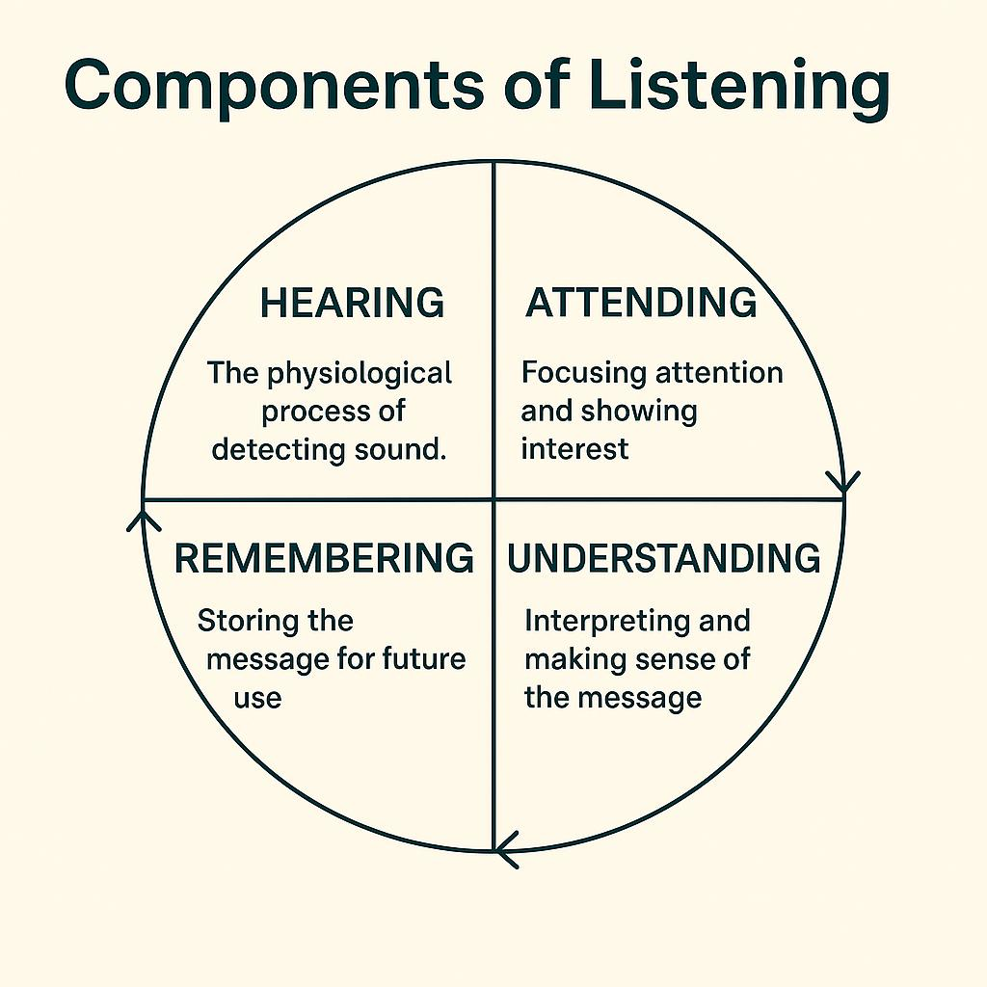
Components of Listening
Pearson (2007), inferred that the components of listening are four, they are;
Hearing
The physiological process of detecting sound.
Influenced by noise, fatigue, and distractions.
Attending
Involves focusing attention and showing interest.
Combines cognitive effort with social cues (e.g., nodding, eye contact).
Understanding
Interpreting the message based on context, language, and prior knowledge.
Meaning is shaped by the speaker’s background and the situation.
Remembering
Retaining and recalling information at the right time.
Depends on repetition, rehearsal, and clarity of the message.

Slide 16
How to Listen Effectively
Listening is a skill that involves more than just hearing—it requires full-body awareness and emotional sensitivity (Melgosa & Melgosa, 2002).
Body Listening Techniques (Van-Pelt, 2005):
Listen with the eyes: Maintain steady, respectful eye contact to show attentiveness.
Listen with the head: Nod or tilt your head to signal understanding and engagement.
Listen with the hands: Use gestures or gentle touch to affirm and support.
Listen with the mouth: Smile, laugh, or offer verbal cues like “I see” or “sure” to encourage the speaker.
Listen with the body: Adopt open, relaxed postures to convey receptiveness.
Listen with the mind: Tune into the speaker’s emotions, intentions, and deeper meanings.
Effective Methods of Listening (Van-Pelt, 2002):
Be alert to body language
Observe nonverbal cues like posture, facial expressions, and gestures.
These reveal emotions behind words and help avoid misinterpretation.
Use “door openers”
Phrases like “I see,” “Tell me more,”* or *“You don’t mean it?” invite deeper sharing.
They show respect, interest, and encourage the speaker to continue.
Prevents interruption and promotes a safe space for expression.

Slide 17
Rules of Effective Listening (Van-Pelt, 2002):
Maintain eye contact – Focus fully on the speaker to show attentiveness.
Sit attentively – Eliminate distractions and lean forward slightly to signal interest.
Show interest – Use facial expressions like raised eyebrows, nods, or smiles to engage.
Use affirming phrases – Say things like “I see,” “That makes sense,” to show understanding.
Ask thoughtful questions – Encourage deeper conversation with well-phrased inquiries.
Listen a little longer – Extend your attention beyond the expected to reflect and absorb.
Key Elements of Listening Behavior:
Verbal responses: Asking questions, giving feedback, using appropriate tone.
Nonverbal responses: Eye contact, head nodding, posture, facial expressions.
Note: Up to 70% of message interpretation relies on nonverbal cues (Cole, 2025).
Steps to Active Listening (Dagari, 2009) :
Pay close attention
Focus on both verbal and nonverbal cues.
Tune in to the speaker’s emotions, intentions, and context.
Respond appropriately
Use verbal or nonverbal signals to show you’re engaged.
Express your own thoughts respectfully using “I” messages to avoid blame.
Ensure your feedback is calm, clear, and empathetic.

Slide 18
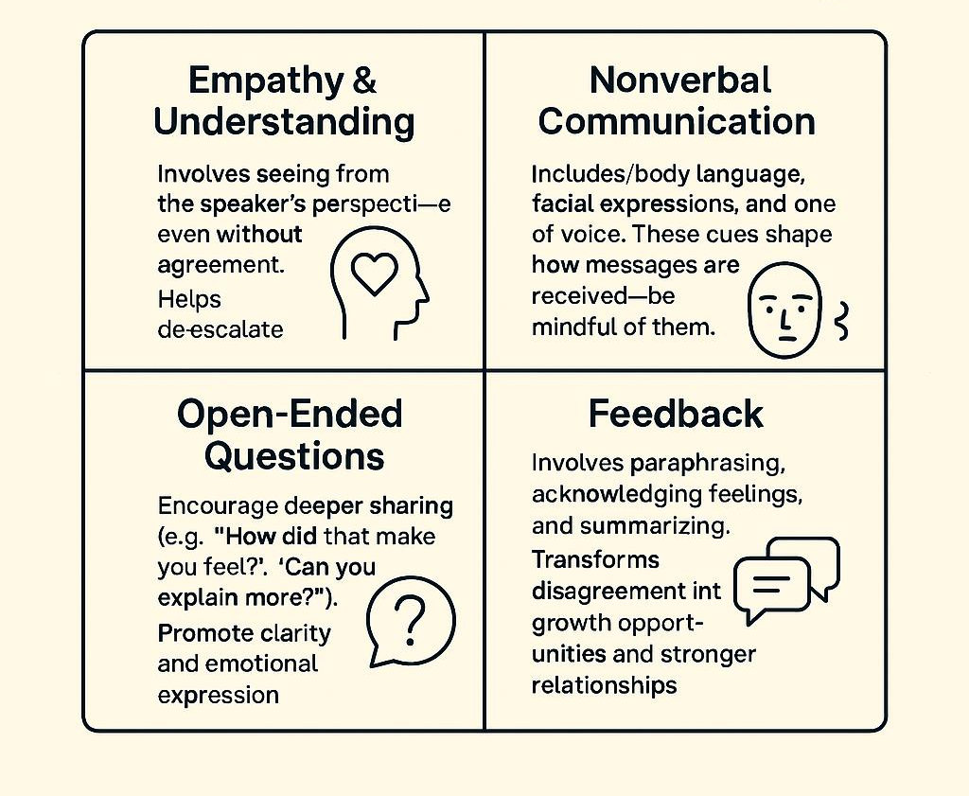
Empathy, Nonverbal Cues & Feedback in Active Listening
Empathy & Understanding
Involves seeing from the speaker’s perspective—even without agreement.
Helps de-escalate conflict and build rapport and trust.
Nonverbal Communication
Includes body language, facial expressions, and tone of voice.
These cues shape how messages are received—be mindful of them.
Open-Ended Questions
Encourage deeper sharing (e.g., “How did that make you feel?”, “Can you explain more?”)
Promote clarity and emotional expression.
Feedback
Involves paraphrasing, acknowledging feelings, and summarizing.
Transforms disagreement into growth opportunities and stronger relationships.

Slide 19
Tips to Improve Active Listening Skills (Dagari, 2009)
Commit to respectful communication
Practice humility, honesty, compassion, and openness to correction.
Listen without interrupting
Allow the speaker to fully express their thoughts before responding.
Avoid premature conclusions
Hear the entire message before forming judgments.
Focus on content, not distractions
Ignore speech quirks or mannerisms that may divert your attention.
Stay open-minded
Be flexible and willing to learn from the speaker’s perspective.
Use verbal responses
Ask clarifying questions (e.g., “Do you mean…?”, “I see what you’re saying”).
Use nonverbal cues
Maintain eye contact, nod, and show attentiveness through body language.
Key Communication Practices:
Focus on the conversation
Use clear, simple language.
Avoid jargon or ambiguous terms.
Pay full attention to the speaker’s message.
Ensure clarity of information
Speak in a language familiar to the listener.
Avoid vague expressions—aim for precision and coherence.
Foster mutual respect
Refrain from interrupting.
Maintain eye contact and a respectful tone.
Uphold dignity in both speaking and listening roles.
Encourage feedback and options
Create space for clarification and response.
Use feedback to gauge acceptance or rejection of proposals.
Promote shared ownership of the resolution process.

Slide 20
Effective Communication Techniques to Reduce Conflict (Cole, 2025)
The Defusing Technique
Acknowledge the other person’s point of view to reduce anger.
Example: “You’re absolutely right. I need to be more responsible.”
Validates the speaker and promotes resolution.
Empathy
Thought empathy: Shows understanding of the speaker’s message.
Feeling empathy: Acknowledges the speaker’s emotions.
Exploration
Ask gentle, open-ended questions to encourage deeper sharing.
Example: “Are there any other thoughts you’d like to share?”
Using “I” Statements
Express your own feelings without blaming others.
Example: “I feel upset that this has come between us.”
Stroking
Offer sincere, positive affirmations—even during conflict.
Example: “I admire your strength and honesty in bringing this up.”

Slide 21
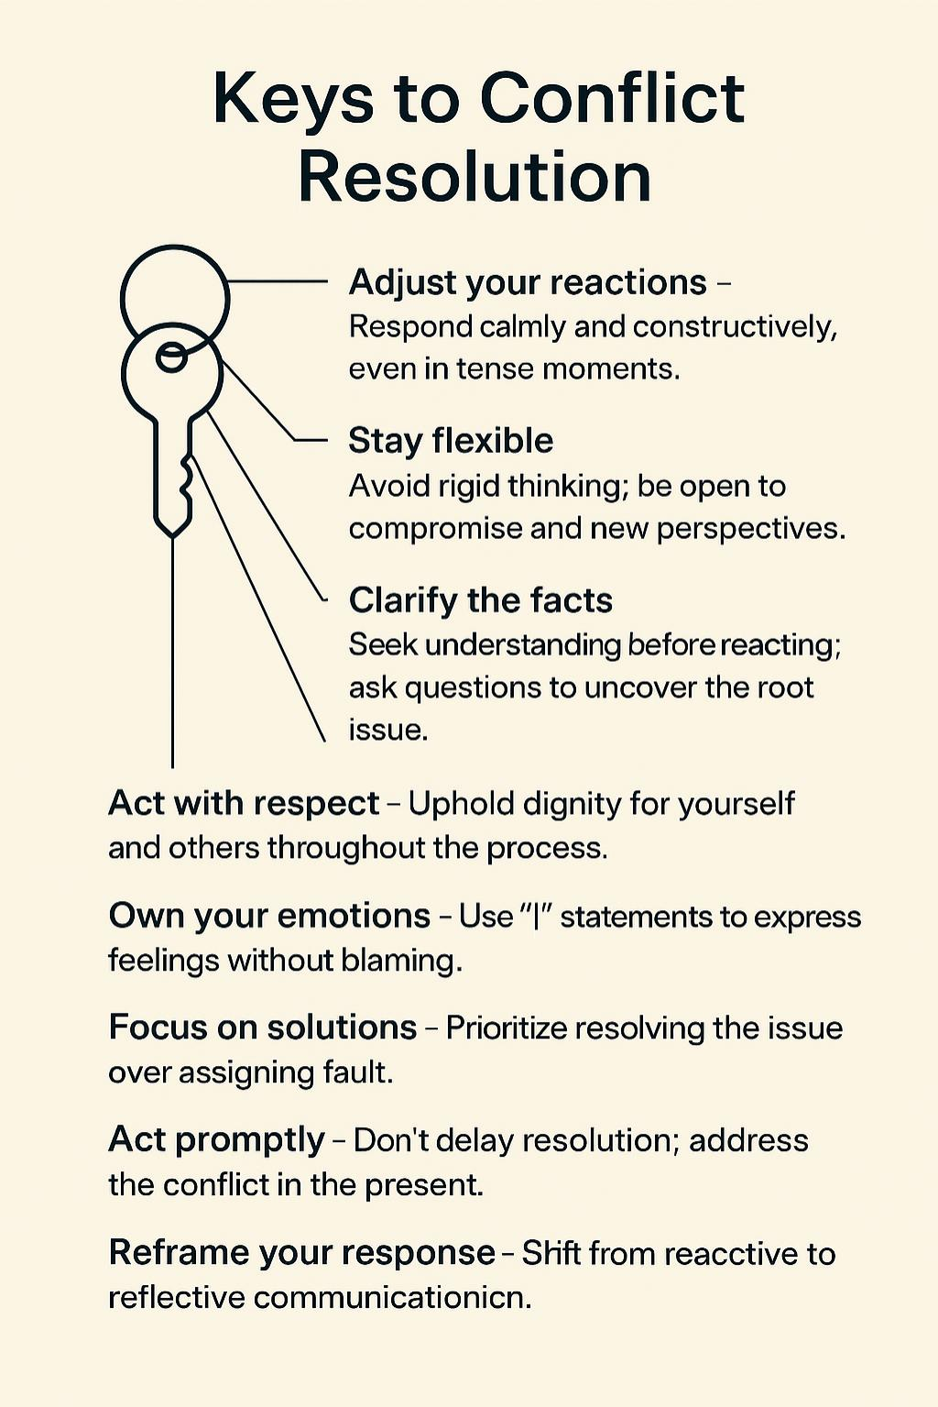
Keys to Conflict Resolution
Adjust your reactions – Respond calmly and constructively, even in tense moments.
Stay flexible – Avoid rigid thinking; be open to compromise and new perspectives.
Clarify the facts – Seek understanding before reacting; ask questions to uncover the root issue.
Act with respect – Uphold dignity for yourself and others throughout the process.
Own your emotions – Use “I” statements to express feelings without blaming.
Focus on solutions – Prioritize resolving the issue over assigning fault.
Act promptly – Don’t delay resolution; address the conflict in the present.
Reframe your response – Shift from reactive to reflective communication.

Slide 22
Things to Consider About Conflict
Conflict is a natural part of life
It’s not inherently negative — it can lead to growth and understanding.
Occurs at all levels of interaction
Even strong relationships face conflict due to stress, gossip, miscommunication, or differing goals.
Conflict is a turning point
When handled well, it fosters mutual respect, deeper understanding, and stronger bonds.
Resolution matters more than frequency
The quality of conflict resolution determines the health of a relationship —not the number of disagreements.

Slide 23
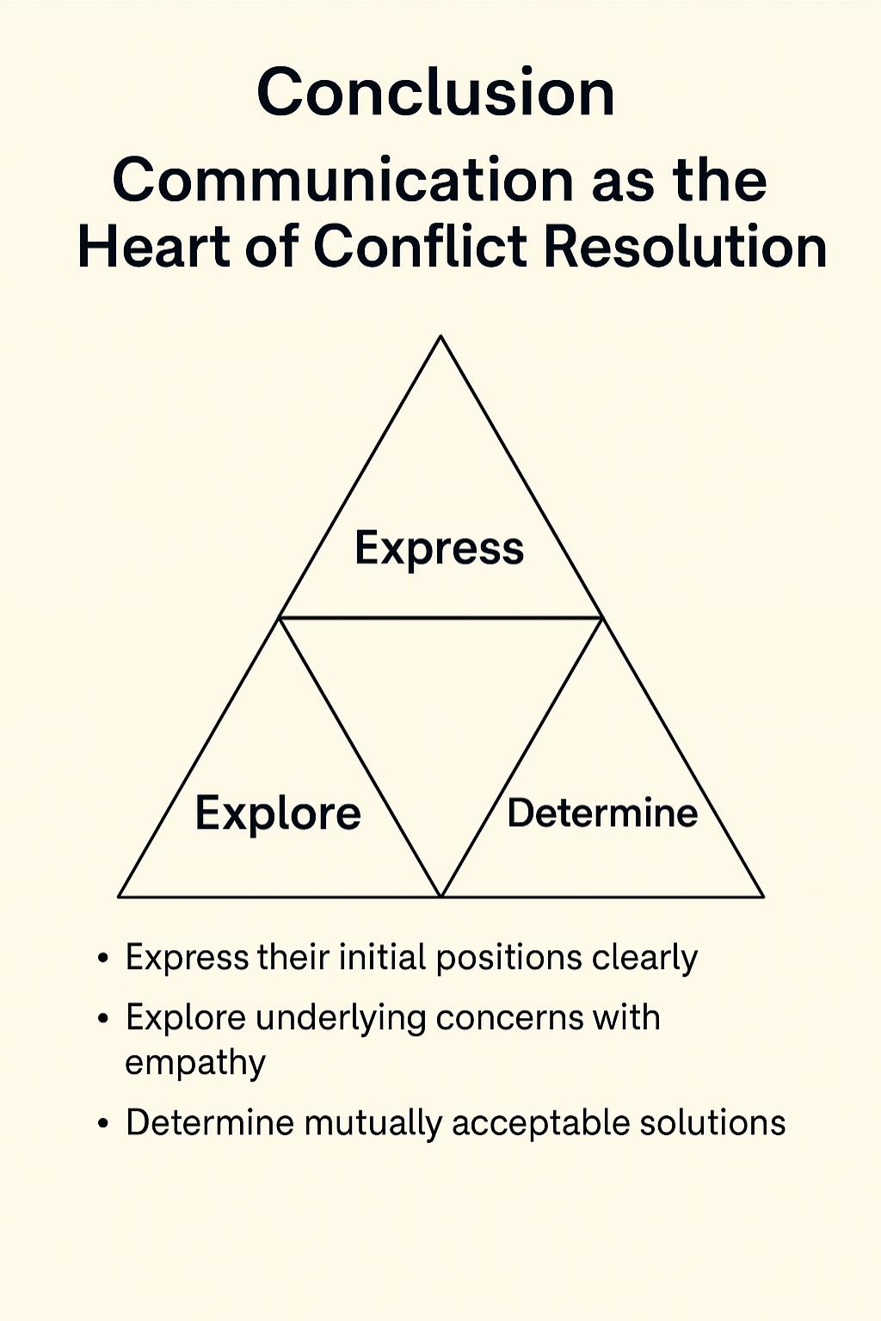
Conclusion: Communication as the Heart of Conflict Resolution
The quality of communication shapes the depth and success of human interaction.
The ability to express oneself and be heard fosters joy, satisfaction, and emotional well-being.
Life stressors and emotional disagreements often disrupt communication and lead to conflict.
Resolving conflict requires a collaborative process of working through opposing views toward a shared goal.
At the core of resolution lies effective communication, which enables individuals to:
Express their initial positions clearly
Explore underlying concerns with empathy
Determine mutually acceptable solutions

Slide 24
Thanks For Your Attention!
Dr. Bilhatu Kumah Dagari
08036153436
bilhatudagari@gmail.com
Department of Educational Psychology and Counselling,
Faculty of Education,
Ahmadu Bello University, Zaria, Nigeria.

