Slide 1
AI skills for enhanced guidance and counseling goals.
PRESENTed
by
Prof l. i. oborkhale
Director centre fOR AI

Slide 2
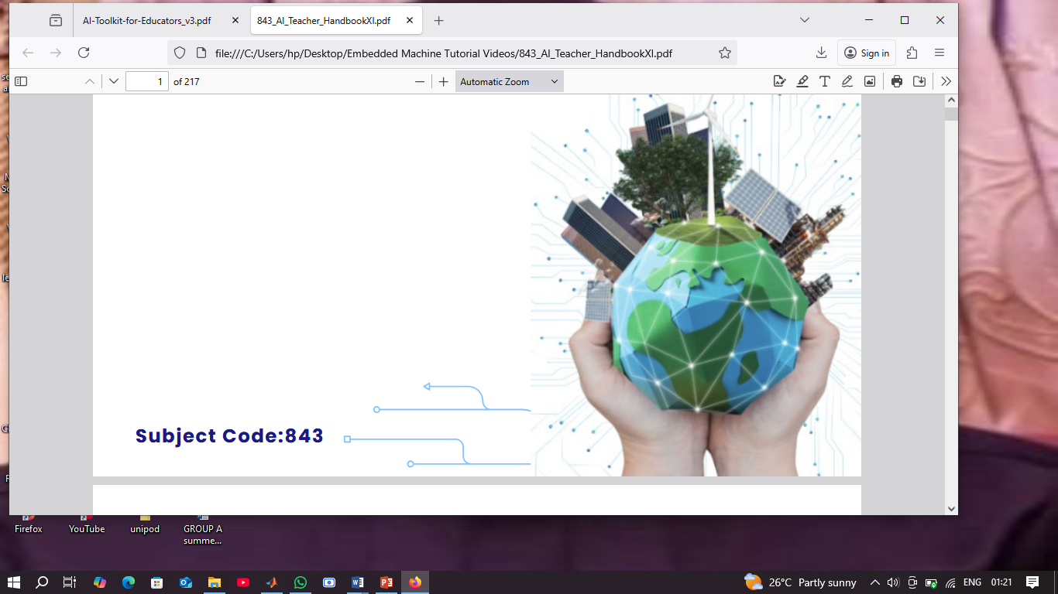
What is artificial intelligence
When a machine……
Mimics human intelligence
Can solve real world problems
Improve on its own from past experiences
Can predict and make decisions on its own
……it can be termed as artificially intelligent!

Slide 3
ARTIFICIAL INTELLIGENCE
,
Algorithm/model
AI
machine
Data

Slide 4
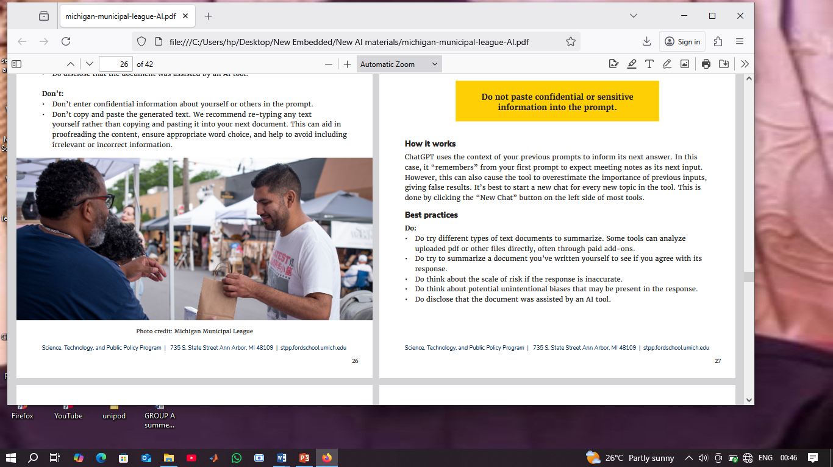
Guidance and counselling
Guidance helps individuals make informed decisions about education, career, or life transitions.
Counselling focuses more on emotional, psychological, or behavioral support, often one-on-one, and can address personal challenges.
🎯 Goals
Promote personal growth and development
Support mental and emotional well-being
Help with academic, career, and social decisions
Foster resilience and problem-solving skills

Slide 5

Integrating AI into counselling practice
Integrating AI into counselling practice can be a game-changer—if done thoughtfully. It’s not just about using fancy tech; it’s about enhancing care, improving access, and supporting both clients and practitioners.
The integration of Artificial Intelligence (AI), including machine learning and natural language generation, in counseling practice offers significant potential for enhancing efficiency and effectiveness.

Slide 6
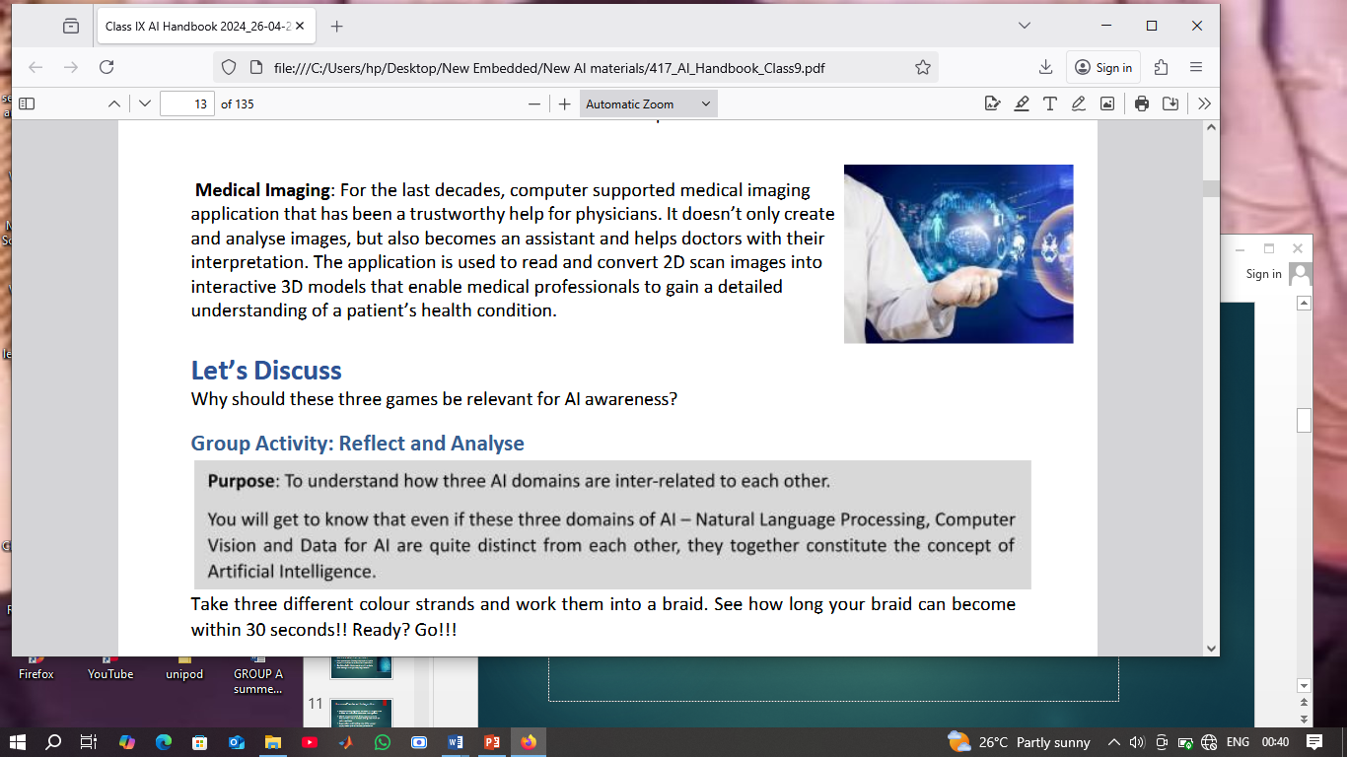
Key Areas of Integration
Client Intake & Assessment
Use AI-powered chatbots or screeners to gather initial data, identify risk factors, and streamline triage.
Session Support Tools
AI can assist with note-taking, emotion detection, and summarizing key themes from sessions using natural language processing (NLP).
Treatment Planning
Machine learning algorithms can suggest evidence-based interventions based on client profiles and historical outcomes.
Progress Monitoring
AI tools can track mood, engagement, and behavioral patterns between sessions to help adjust treatment plans.
Career & Educational Guidance
AI can analyze labor market trends and match clients with suitable career paths or training programs.

Slide 7
Ethical & Practical Considerations
Informed Consent
Always explain how AI tools are used and get explicit permission from clients.
Data Privacy & Security
Choose platforms that comply with local privacy laws and embed “privacy by design” principles.
Bias & Fairness
Be aware of algorithmic bias. Regularly audit tools to ensure equitable treatment across diverse populations.
Human Oversight
AI should support—not replace—your clinical judgment. Maintain the therapeutic relationship as the core of your practice.

Slide 8
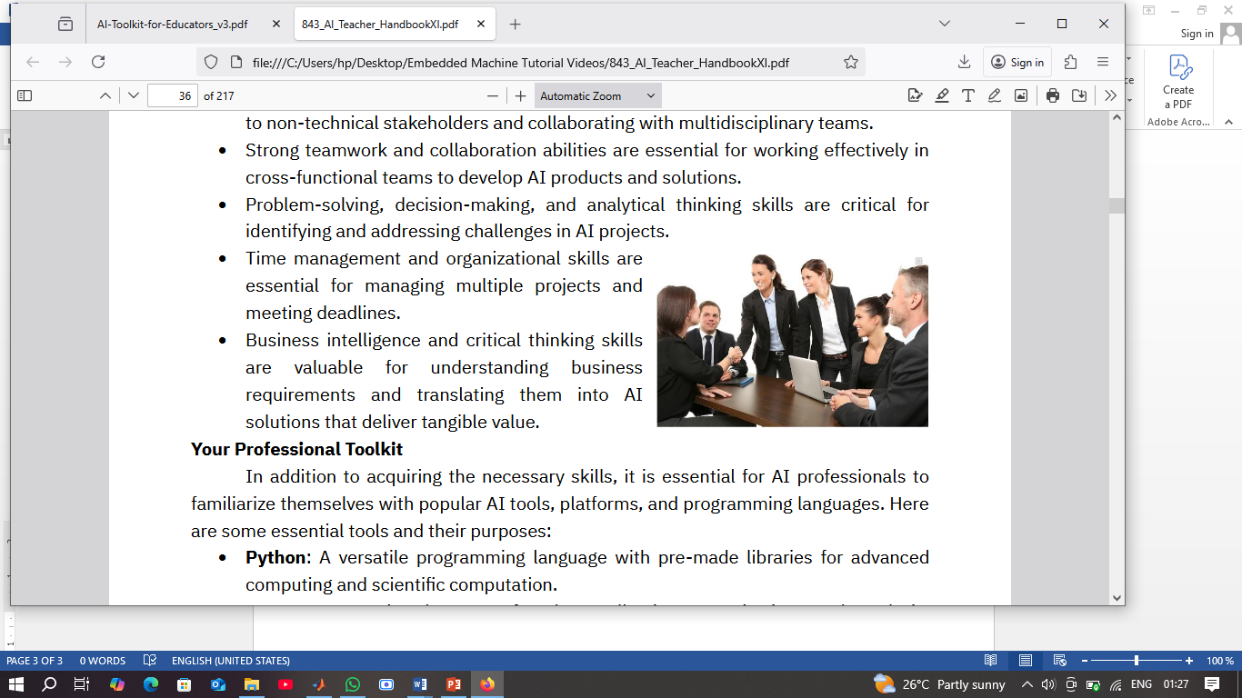
Human-Centered Integration
Empathy and judgment: Balance AI insights with human intuition and emotional intelligence.
Client empowerment: Encourage clients to discuss their use of AI tools and guide them on safe practices.
Supervision and training: Use AI to support supervisees and enhance professional development.

Slide 9

AI-related skills and competencies :
Foundational Knowledge of AI
  Understanding AI basics: Know how AI works, including algorithms, machine learning, and natural language processing.
  Familiarity with AI tools: Learn about chatbots, predictive analytics, and virtual platforms used in counselling

Slide 10
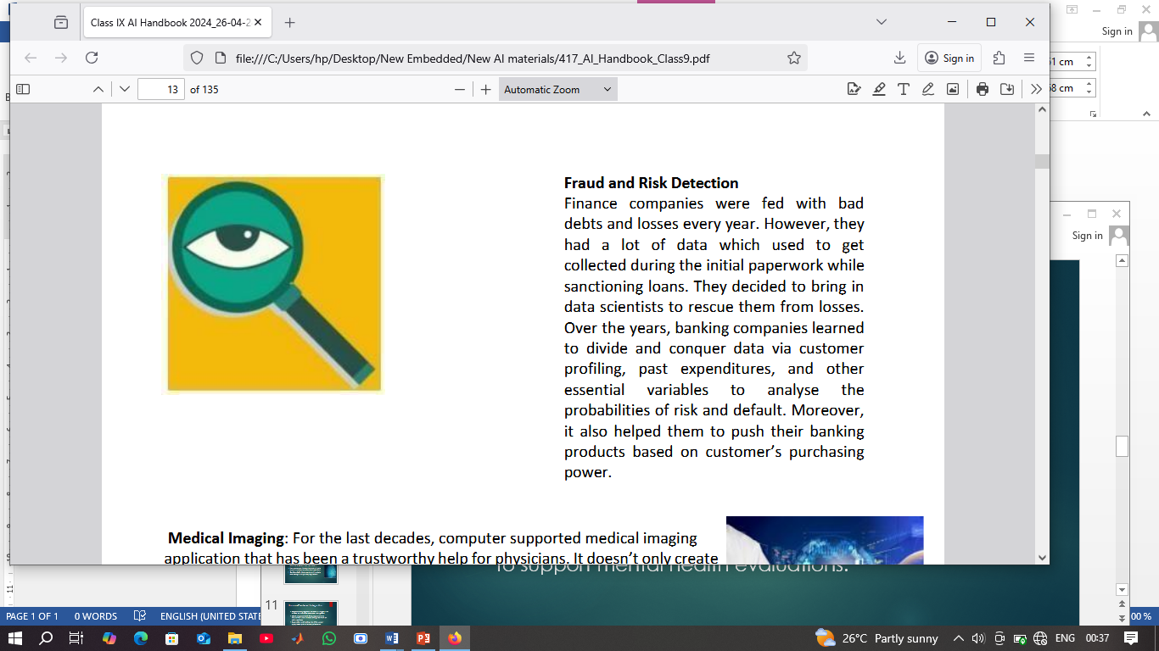
Technical and Analytical Skills
Data interpretation: Use AI to analyze client data for patterns and insights that inform treatment plans.
Digital literacy: Navigate AI-powered platforms for scheduling, record-keeping, and virtual sessions.
Assessment tools: Employ AI-assisted diagnostics to support mental health evaluations.

Slide 11
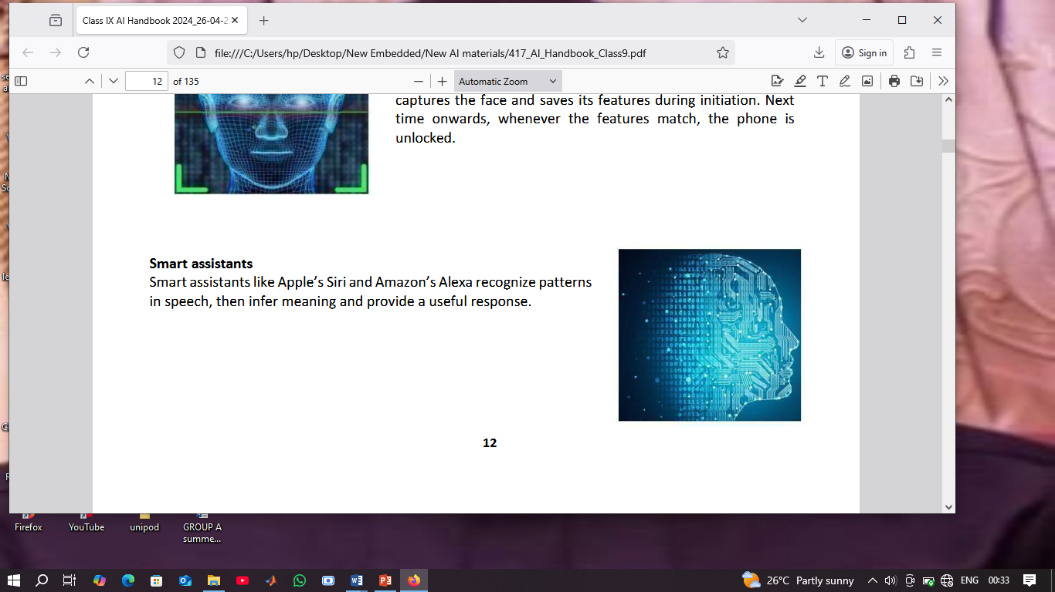
Ethical and Professional Competence
Informed consent: Clearly explain AI use to clients and obtain their permission.
Bias awareness: Recognize and mitigate algorithmic bias to ensure fair treatment.
Confidentiality: Safeguard sensitive data and comply with privacy regulations.

Slide 12
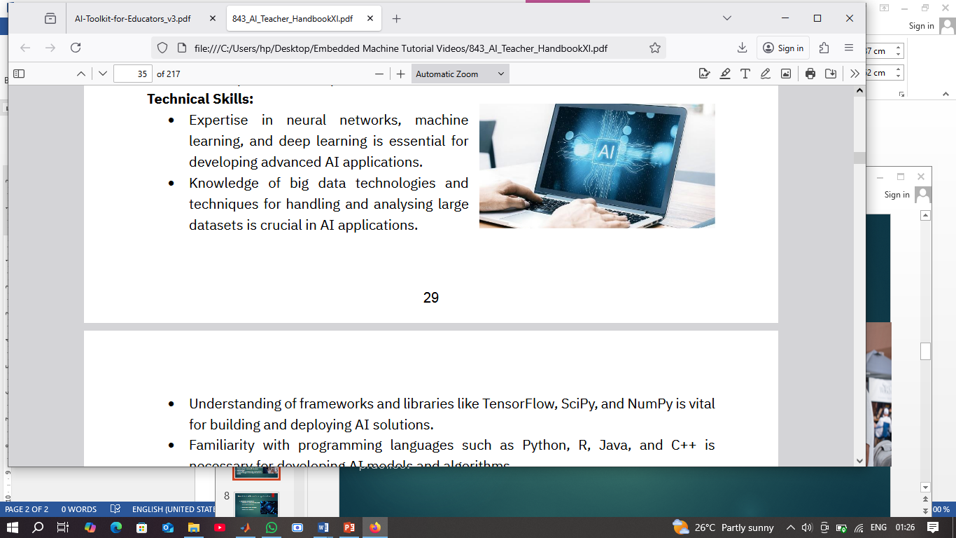
Career and Educational Guidance
Labor market analysis: Leverage AI to track employment trends and advise clients on career paths.
Virtual reality (VR): Explore immersive tools for treating conditions like PTSD: Post-Traumatic Stress Disorder and anxiety.

Slide 13
Approaches to enhance skills
Creative learning
Creative learning" is an approach to education that emphasizes imagination, curiosity, and innovation, helping learners engage more deeply with ideas by thinking outside the box.
It’s less about memorizing facts and more about exploring, experimenting, and problem-solving in new and meaningful ways

Slide 14
Core Elements of Creative Learning
Here are the key components that define creative learning:
Imagination – Using storytelling, role-play, and fantasy to spark interest.
Exploration – Encouraging learners to ask questions and investigate topics themselves.
Making & Doing – Hands-on activities (e.g., building models, creating art, coding).
Collaboration – Working together to share ideas and solve problems.
Reflection – Thinking about the process and learning from mistakes.

Slide 15
How to Foster Creative Learning
Use open-ended questions: "What if...?" or "How might we...?"
Allow freedom to choose how learners show what they know.
Incorporate multisensory tools: music, visuals, movement.
Provide real-world problems to solve.
Celebrate original thinking, not just correct answers.

Slide 16
Tools That Support Creative Learning
LEGO Education
Scratch (coding )
Tinkercad (3D design)
Padlet or Jamboard for brainstorming
Flip (formerly Flipgrid) for student video reflections

Slide 17
Design Thinking
Design thinking is a non-linear, iterative process that expert teams use to understand users, challenge assumptions, redefine problems Design Thinking framework
Design Thinking is a design methodology that provides a solution-based approach to solvingproblems.
It’s extremely useful in tackling complex problems that are ill-defined or unknown.and create innovative solutions to prototype and test

Slide 18
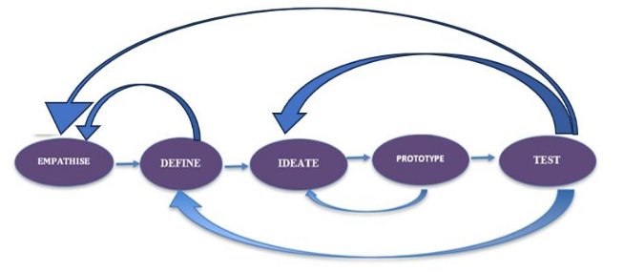
🔁 The 5 Stages of Design Thinking
Stage Description Key
Questions1. Empathize Understand the needs and emotions of the users. Who are we designing for? What do they need?
2. Define Clearly articulate the problem. What is the core problem?
3. Ideate Brainstorm as many ideas as possible. What are some creative solutions?
4. Prototype Create quick, low-cost models of the ideas. What can we build to test our ideas?
5. Test Try out prototypes, get feedback, and improve. Does this solution work? Why or why not?

Slide 19
🎯 Why Use Design Thinking?
Builds creative confidence
Solves real, relevant problems
Encourages collaboration
Promotes iterative learning (learning by doing and refining)

Slide 20
Design Thinking Process
Empathize – Interview classmates and teachers about rainy-day feelings.
Define – Kids feel restless and want physical activity even indoors.
Ideate – Brainstorm: indoor obstacle course, dance videos, board games.
Prototype – Build a mini indoor activity station.
Test – Try it during lunch recess and get feedback.

Slide 21
Empathize
Design thinking begins with empathy. This requires doing away with any preconceived notions and immersing oneself in the context of the problem for better understanding.
In simple words, through empathy, one is able to put oneself in other people's shoes and connect with how they might be feeling about their problem.
As a designer of the solution to a challenge, one should always understand the problem from the end-user perspective. This is done by observation, interaction or by imagination, circumstance, or situation.

Slide 22
Empathy Map
An extremely useful tool for understanding the users’ needs and gaining a deeper insight into the problem at hand is the empathy map. It also helps in deepening that understanding, gaining insight into the user’s behavior.
To create a “persona” or profile for the user, you can use the empathy map activity to create a realistic general representation of the user or users. Personas can include details about a user’s education, lifestyle, interests, values, goals, needs, thoughts, desires, attitudes, and actions

Slide 23
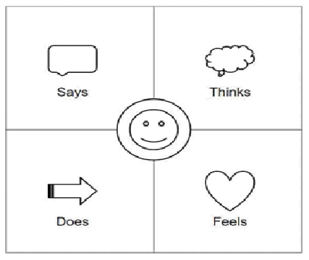
Empathy Map
An Empathy Map is divided into 4 quadrants. —Says, Thinks, Does, Feels
● Says – This quadrant contains whatever the user says aloud
● Thinks – This quadrant depicts the thoughts which user have about the problem
● Does –This quadrant depicts the actions of user
● Feels – This quadrant displays the emotional status of the user.

Slide 24
Creating Empathy Map
Draw the Empathy map grid as shown above. Write down the respective observationsin corresponding quadrants.
These observations can be written directly or can paste a sticky note with the observations in the quadrants.
Let us understand through an example. JOHN is having a desktop computer. She is planning to buy one new Laptop for her educational purpose. Let us create an Empathy map for JOHN.

Slide 25
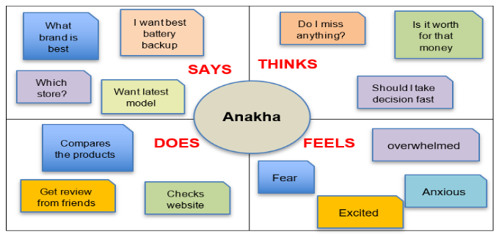
Empathy Map for JOHN
JOHN

Slide 26
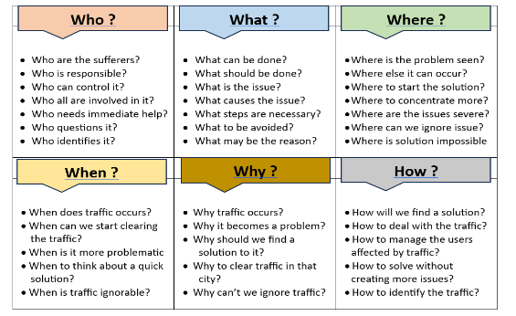
Define
In the Define stage, information collected during Empathize is used to draw insights and is instrumental in stating the problem that needs to be solved.
In order to extract / gather relevant facts and information from users/customers, it is recommended to use this simple and reliable method of questioning: the 5W1H method–i.e. asking questions starting with Who? What? When? Where? Why? and How?
For Example, for the traffic issue in a city, we could define the problem in detail after getting the answers of 5W1H questions. Sample questions of the problem is given in the diagram.

Slide 27
Ideate
By now the problem is obvious and it is time to brainstorm ways and methods to solve it. At this stage, numerous ideas are generated as a part of the problem-solving exercise. Ideation is all about idea generation.
During brainstorming, one should not be concerned if the generated ideas are possible, feasible, or even viable. The only task of the thinkers is to think of as many ideas as possible for them
There are some essential ideation techniques employed to generate numerous ideas

Slide 28
Ideation techniques
Brainstorm
During a Brainstorming session, students leverage the synergy of the group to generate new innovative ideas by building on others’ ideas. Participants should be able to discuss their ideas freely without fear of criticism.
Brain dump
Brain dump is very similar to Brainstorm; however, it’s done individually. It allows the concerned person to open the mind and let the thoughts be released and captured onto a piece of paper.
Brain writing
Brain writing is also very similar to a Brainstorm session and is known as ‘individual brainstorming’. At times only the most confident of team members share their ideas while the introverts keep the ideas to themselves.

Slide 29
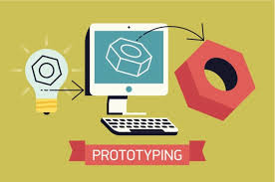
Prototype
The prototype stage involves creating a model designed to solve consumers‘ problems which is tested in the next stage of the process.
Creating a prototype is not a detailed process. It may include a developing simple drawing, poster, group role-playing, homemade “gadget, or a 3d printed product.”
The prototypes must be quick and easy to develop and cheap. Therefore, prototypes are visualized as rudimentary forms of what a final product is expected to look like.

Slide 30
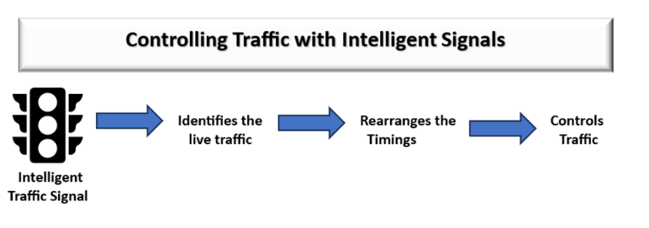
Prototype for any one solution for a traffic issue.

Slide 31
Test
One of the most important parts of the design thinking process is to test the prototypes with the end users. This step is often seen going parallel to prototyping.
During testing, the designers receive feedback about the prototype(s), and get another opportunity to interact and empathize with the people they are finding solutions for.
Testing focuses on what canbe learned about the user and the problem, as well as the potential solution.

Slide 32
Tools & Methods
Empathy maps and journey maps
Sketching, storyboarding, and role play
Prototyping materials: cardboard, paper, LEGOs, digital tools (Tinkercad, Canva)

Slide 33
Computational thinking
Computational thinking is the thinking process behind coding/programming.
It is strictly related to maths, logic, and problem-solving.
Computational thinking helps to understand how to translate a task into a set of instructions that can be run by a computer.

Slide 34
Core Concepts of Computational Thinking
Decomposition
→ Breaking down a complex problem into smaller, more manageable parts.
Example: Splitting the process of building a website into designing, coding, testing, etc.
Pattern Recognition
→ Identifying similarities or patterns in problems or data.
Example: Noticing that login systems often require a username and password.
Abstraction
→ Focusing on the important information only and ignoring irrelevant detail.
Example: When designing a navigation app, only roads and traffic matter—not the color of houses.
Algorithm Design
→ Developing step-by-step instructions for solving problems.
Example: Creating a recipe or a flowchart to sort a list of numbers.

Slide 35
Why is Computational Thinking Important?
Helps in solving real-world problems more efficiently.
Encourages logical thinking and precision.
Builds foundational skills for coding, programming, and STEM disciplines.
Applicable across disciplines, not just computer science (e.g., math, science, even social sciences).

Slide 36
Conclusion
Artificial intelligence (AI) is transforming guidance and counselling by enhancing efficiency, personalization, and access to support
Integrating AI into your counselling practice can be a game-changer—if done thoughtfully.
It’s not just about using fancy tech; it’s about enhancing care, improving access, and supporting both clients and practitioners

Slide 37
Thank you for listening

